Slide 1

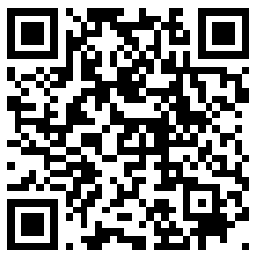
CS2113/T – Lecture 4
Go to* github.com/nus-cs2113-AY2021S2/circus
Fork to your GitHub account
Clone the fork to your computer
Set up the project in IDE
Run the Circus class
Observe:
how inheritance is used
polymorphic behavior of Parrot/Duck objects
overriding of toString method in Parrot/Duck classes
Run text-ui-test/runtest.bat (or .sh)
Also, join the session: http://pollev.com/anarayan
Archipelago session
This lecture will be recorded
This lecture will be recorded
* Reused from previous semester lecture

Slide 2

Bug fix → break other code?
REGRESSIONS
[undesirable side effects of modifications]

Slide 3
Q: Regression testing refers to:
Text UI testing
Automated testing of the SUT
Testing the modifications made
All of the above
None of the above

Slide 4
Four OOP fundamental concepts:
Abstraction
Encapsulation
Inheritance
Polymorphism

Slide 5
Activity: Setup Circus
Go to github.com/nus-cs2113-AY2021S2/circus
Fork to your GitHub account
Clone the fork to your computer
Set up the project in IDE
Run the Circus class
Observe:
how inheritance is used
polymorphic behavior of Parrot/Duck objects
overriding of toString method in Parrot/Duck classes
Run text-ui-test/runtest.bat (or .sh)
Try to follow along as much as possible.
If you miss some steps, it is OK
Commit and push somethings when instructed

Slide 6
Inheritance hierarchy in the Circus project
Parent
Child1
Child2

Slide 7
Activity: Casting
Examine the Trainer class
Polymorphism – getToSpeak()
Casting
ClassCastException – train the Parrot
instanceOf

Slide 8
Casting quiz
Shape
Circle
Box
1. Box b0 = new Shape();
2. Shape s0 = new Box();
Shape s1 = new Shape();
3. Object o1 = (Object)s1;
Object o2 = new Circle();
4. Box b1 = (Box)o2;
5. Box b2 = (Box)o1;
6. Circle c1 = (Circle)o2;
Not OK. Parent class object being assigned to child class variable.
OK. Child class object is implicitly upcasted to parent class.
OK. Explicit upcast is not even required.
Not really a Box object. Causes ClassCastException.
Not really a Box object. Causes ClassCastException.
OK. o2 is really a Circle object.

Slide 9
Activity: Prevent creating Animal objects
What about Bird?
What about speak() method?

Slide 10
Q: When you make the Animal class abstract, you should make the speak method abstract
True
False
When you make a method abstract, the class has to be abstract; however, when the class is abstract, it is not necessary to make the method abstract. We can have default implementation.

Slide 11
Activity: Give Animal a value

Slide 12
Abstract class/methods & Interfaces
Cannot create instances of both
cannot call new <InterfaceName>() or new <AbstractClassName>()
Abstract class – type hierarchy
Interface – behavior specification
- no single inheritance restriction
Both can be used as types

Slide 13
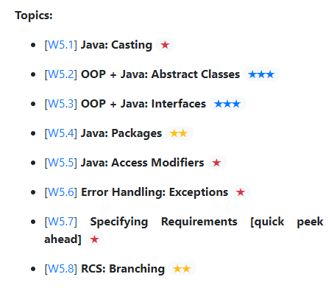



$$✓$$
$$✓$$
$$✓$$

Slide 14
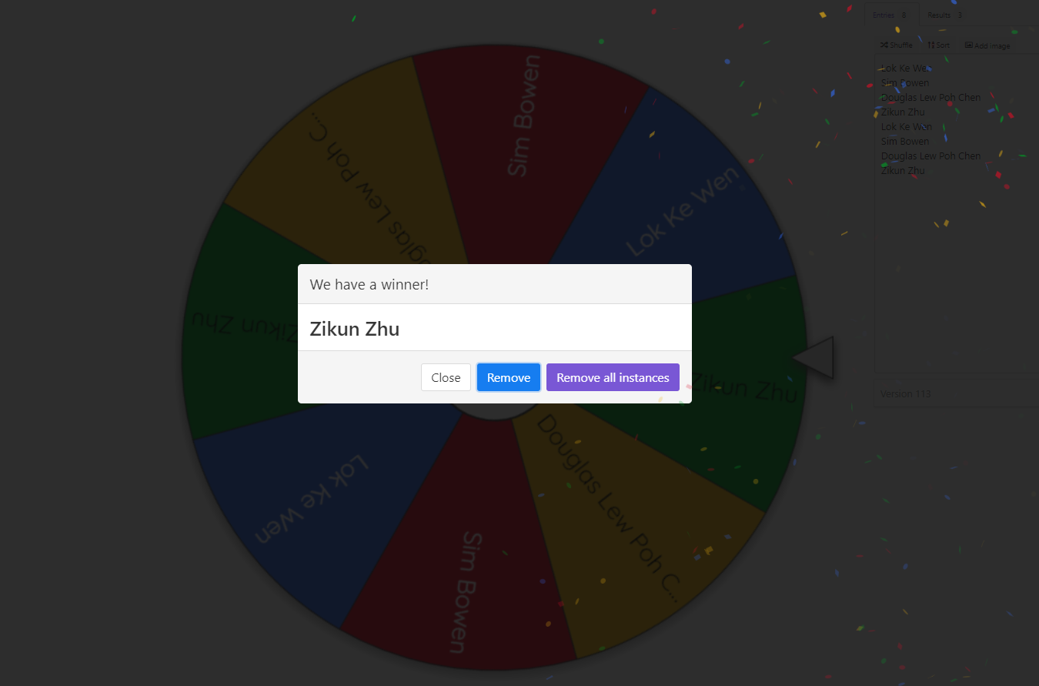
Spin the wheel!

Slide 15
Activity: Packages
Move all classes to a circus package
Move Animal classes into a circus.animal package
Run regression tests

Slide 16

$$✓$$
$$✓$$
$$✓$$
$$✓$$

Slide 17

Pull Request (PR)
Repo on remote server
Forked repo on GitHub
GitHub
fork
push
pull
push
clone
Local repo
Local repo
init
commit
Duke dev
You

Slide 18
Git Branching
HEAD
master
7
Merge commit
HEAD
master
6
Merge fix1 to master
HEAD
master
5
4
fix1
HEAD
3
fix1
HEAD
HEAD
HEAD
master
2
fix1
HEAD
1

Slide 19
Default (if possible)
Fast-forward merge
Merge without Fast-forward
5
HEAD
master
4
fix1
4
fix1
4
3
3
3
HEAD
master
2
2
2
Merge fix1 to master
1
1
1

Slide 20
Activity: Branch
Create a branch named in-lecture
Commit the changes you did
Push to your fork

Slide 21
Syncing branches
HEAD
9
fix1
8
7
HEAD
6
fix1
master
5
master
5
4
fix1
HEAD
4
3
Merge master to fix1
3
2
2
1
1

Slide 22
Activity: Sync Branch
Go back to master
Create add-documentation branch & make a commit
Go back to master
Merge add-documentation branch to master
Observe the merge used fast-forward
Merge master to in-lecture branch to sync it with master
Checkout the improved branch
Merge improved branch to master, without fast-forward
Push master branch to your fork

Slide 23
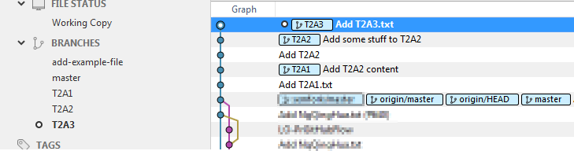
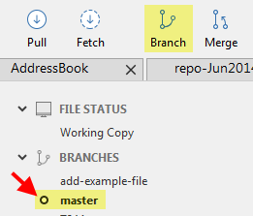
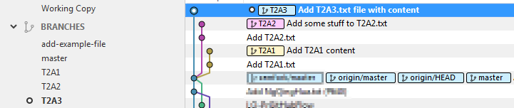
Switch to/checkout master branch before creating a new branch.
A rookie mistake
Can fix?

Slide 24

> git make a mess
> git try to recover
> git start over

Slide 25
Exceptions
Watch video!
Use it in your iP (and in tP later!)

Slide 26



$$✓$$
$$✓$$
$$✓$$
$$✓$$
$$✓$$
$$✓$$
$$✓$$

Slide 27

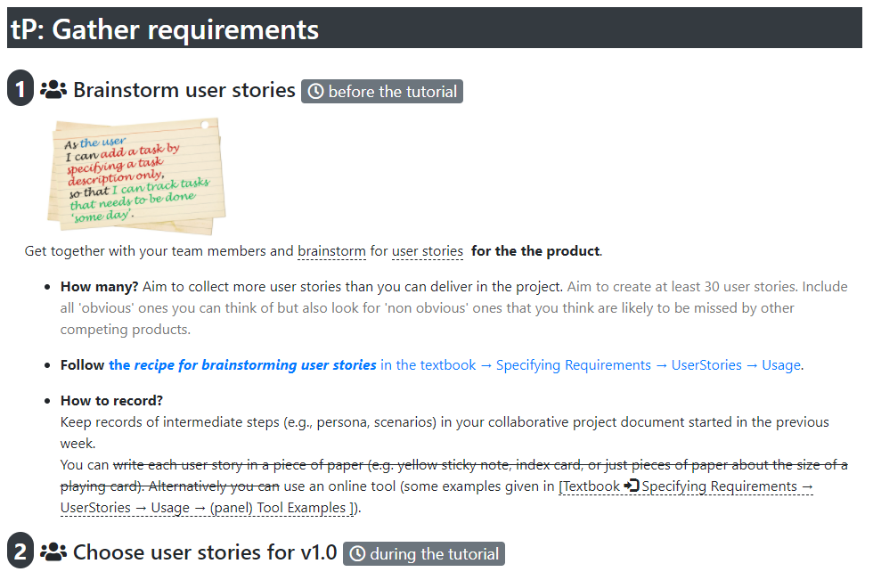
You did conceptualization this week (target user profile, and problem addressed)
Do this next week before tutorial
In the tutorial – do some planning
Each depends on the earlier; so don’t fall behind!

Slide 28
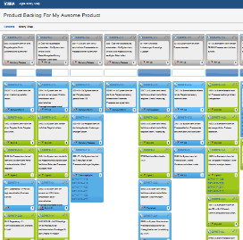
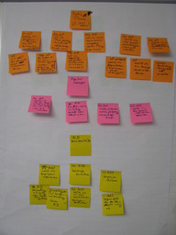
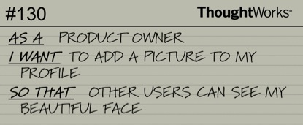
Collect user stories before the tutorial
Prioritize them, group them etc., during the tutorial
User stories
Role
Goal/Function
Benefit

Slide 29
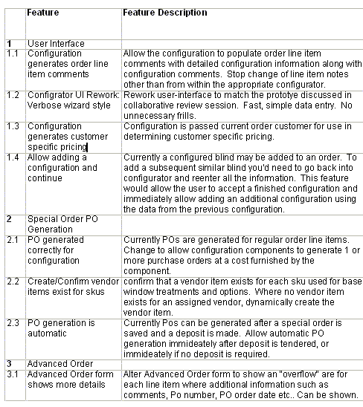
Feature lists

Slide 30
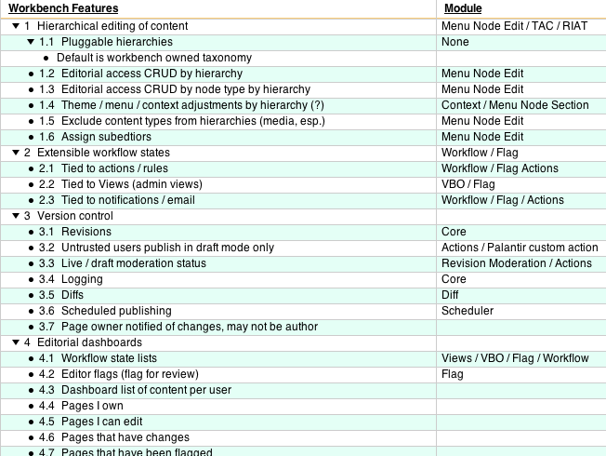
Feature lists

